Slide 1
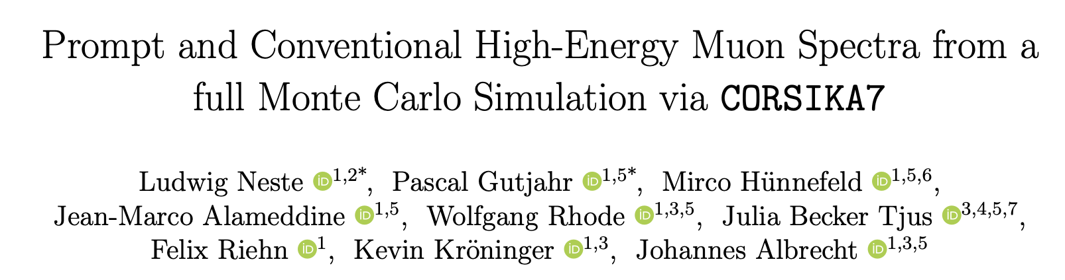
https://arxiv.org/pdf/2502.10951 submitted to EPJC on February 18

Slide 2
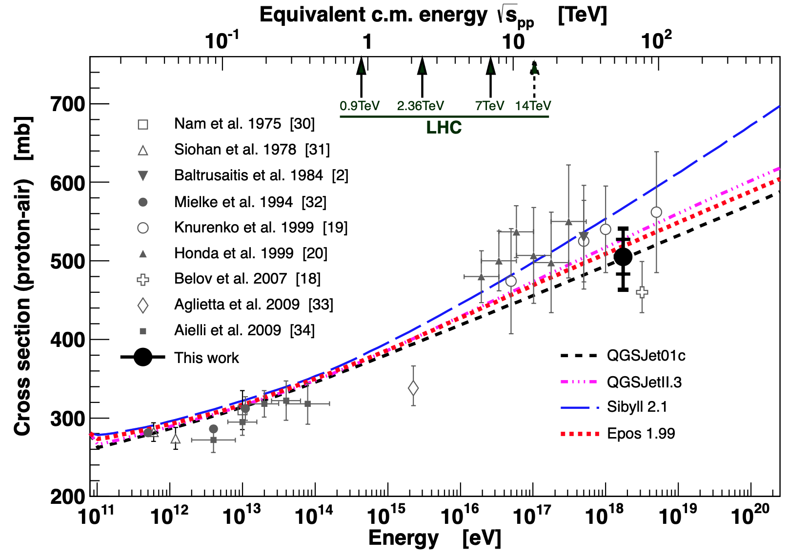
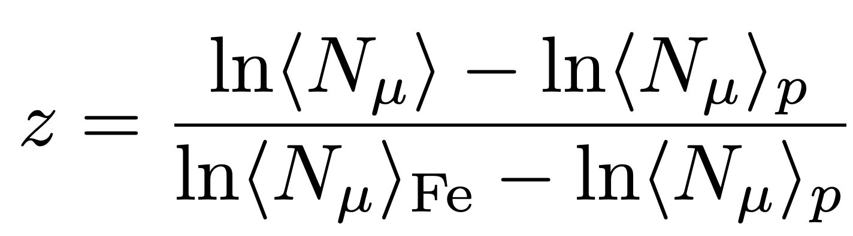
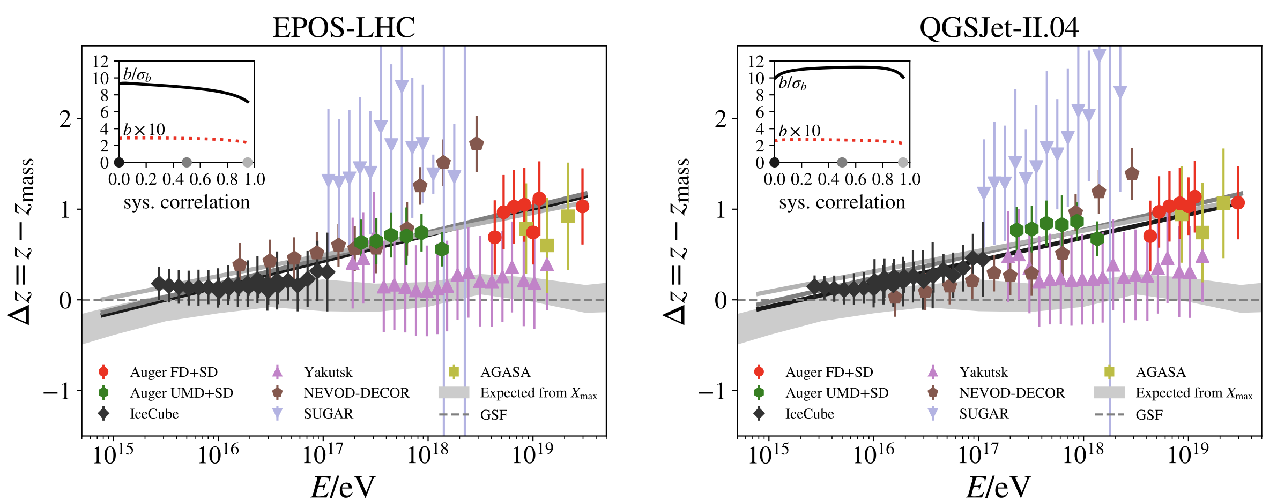
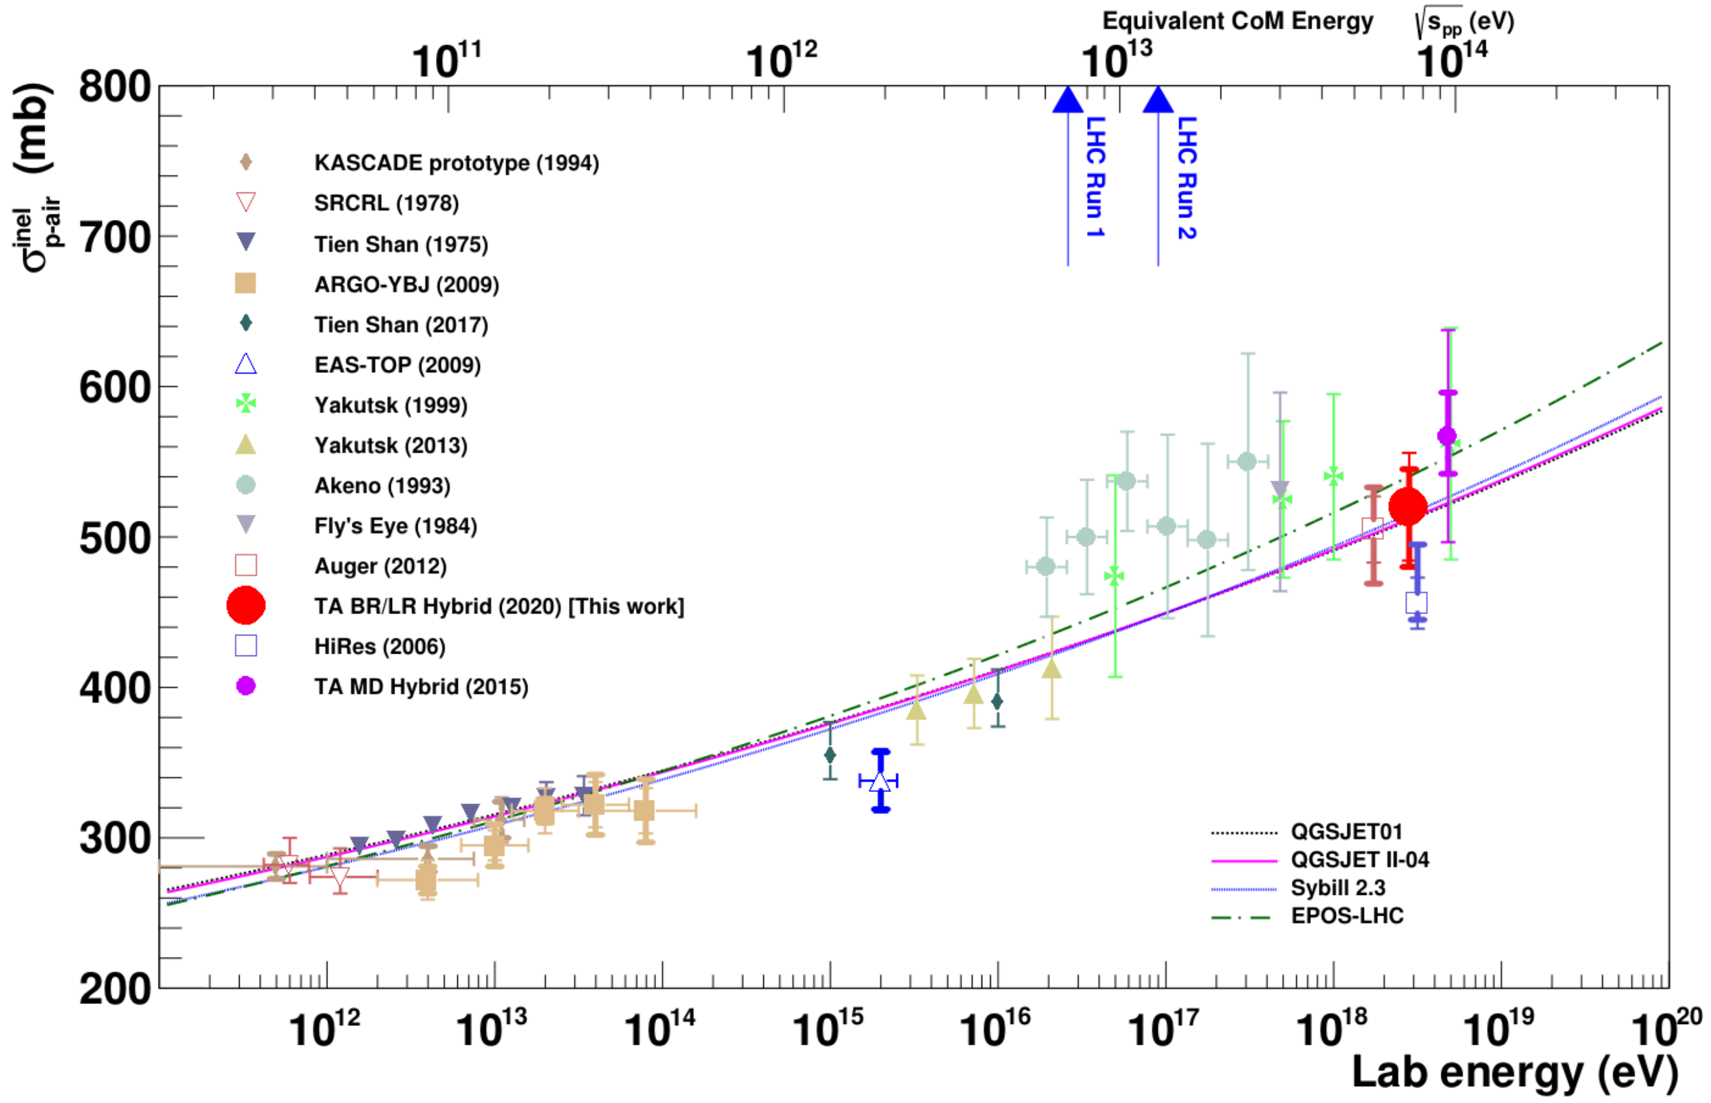
Muon puzzle and hadronic uncertainties
”muon number”
Expected z
(“muon number”)
2012
2108.08341
1208.1520
Uncertainties at E > 10 PeV
2020
More muons measured than simulated for E > 40 PeV ~ cms 8 TeV
2006.05012

Slide 3

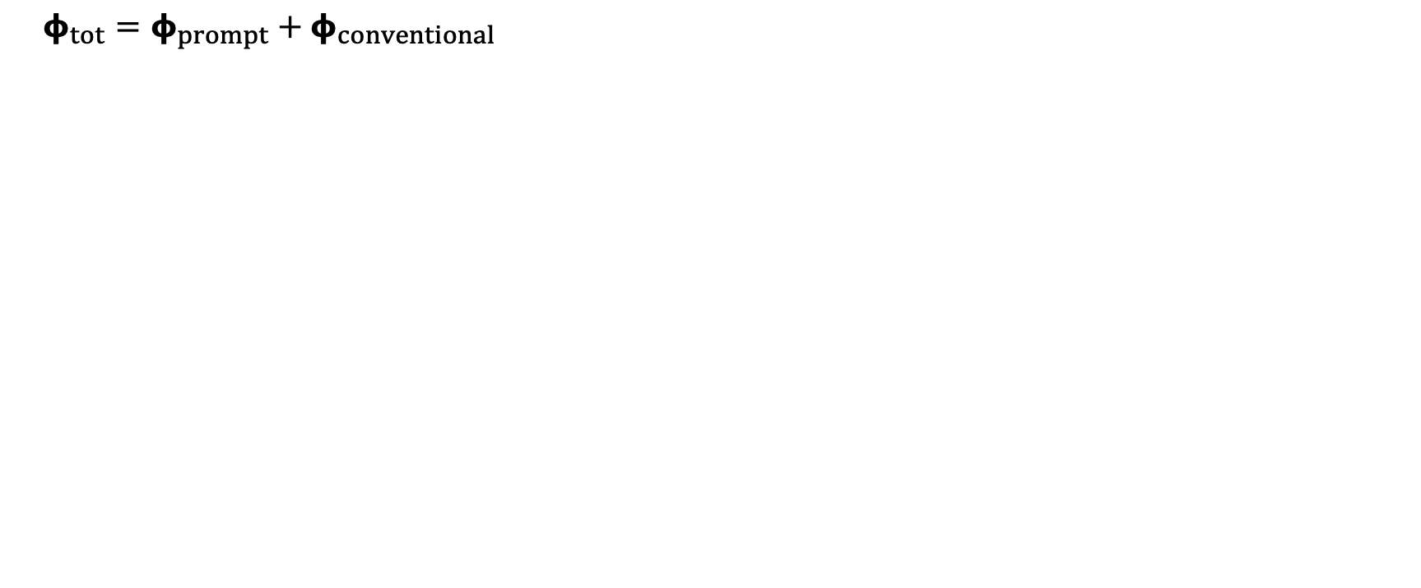
Muon flux
Most energetic muon in bundle
Muon parent:
pion or kaon
yes
no
$φ_{tot}=φ_{prompt}+$ $φ_{conventional}$
conventional
prompt
Credit: Ludwig Neste
Notes:
gamma = 2.7: SNR → fermi/shock acceleration, propagation of cosmic rays lead to interactions with galactic magnetic fields, interactions with gas, energy losses (ionization and nuclear interactions), in this process, some cosmic rays can escape the magnetic fields → this rate is energy dependent → higher-energtic cosmic rays escape more quickly → steepening of spectrum to ~2.7

Slide 4
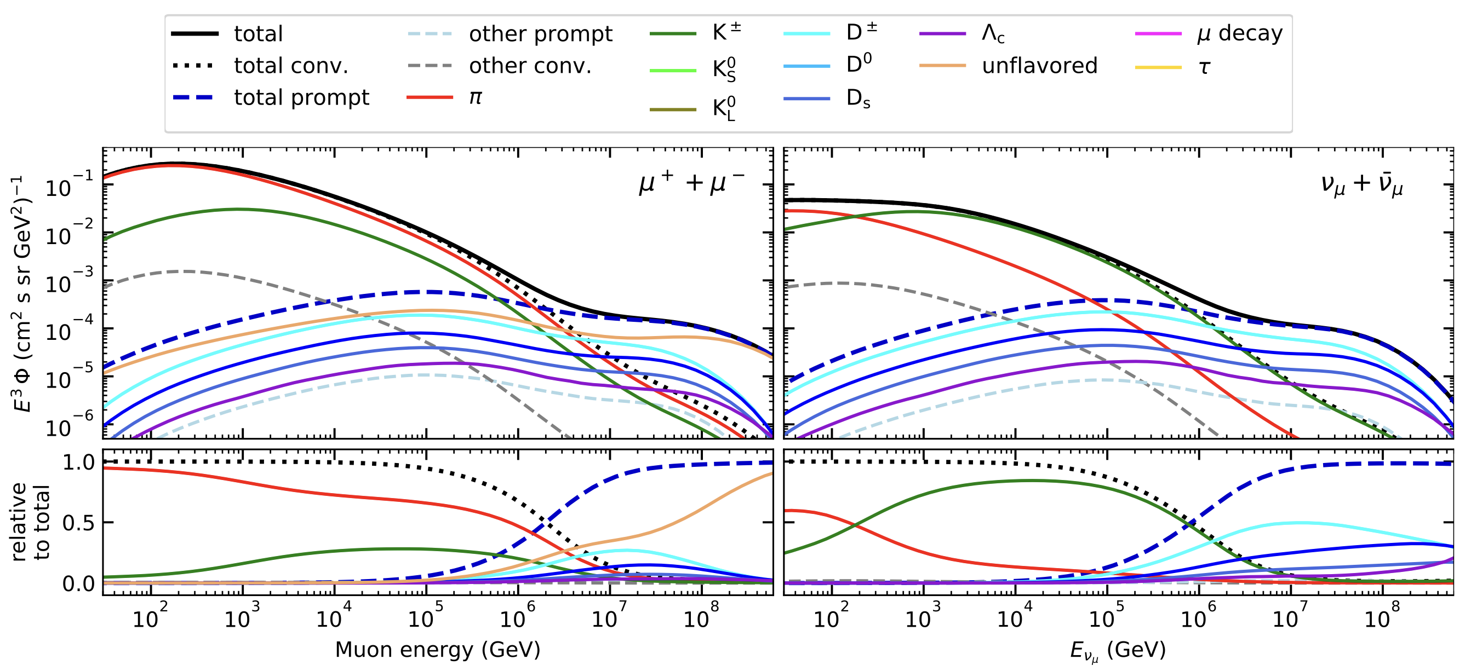
Prompt atmospheric muons and neutrinos
10.1103/PhysRevD.100.103018
no unflavored
dominated by pions
dominated by kaons
Combined fit:
handle on pion/kaon ratio
handle on charmed mesons

Slide 5
Analysis goals
Measure prompt component of the atmospheric muon flux
Unfold a muon energy spectrum
Idea:
New CORSIKA simulations with extended history
Tag muons by parent → prompt or conventional
Scale amount of prompt particles
Scaling saves time and resources instead of doing multiple simulations with different interaction models
Perform forward fit of the prompt normalization
Future:
Measure prompt neutrinos
Combined muon and neutrino fit → pion/kaon ratio

Slide 6
The paper includes…

Slide 7
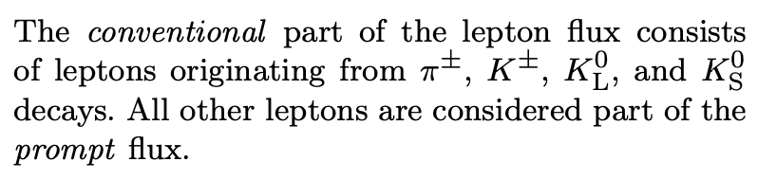
What is prompt?

Slide 8
Tagging prompt in air shower simulation
…is not so easy…because: CORSIKA 7
extended history: add two ancestors of final lepton
Hadron Generation Counter (HGC)
increases by 1 with each hadronic interaction
exceptions like +30 for charm decay
HGC can be negative
parent particle is not always the parent particle
…
Parent particles can be unknown
not distinguished between pion and kaon
Credit: Ludwig Neste
technical details can be found in Ludwig’s Master thesis in the nextcloud

Slide 9
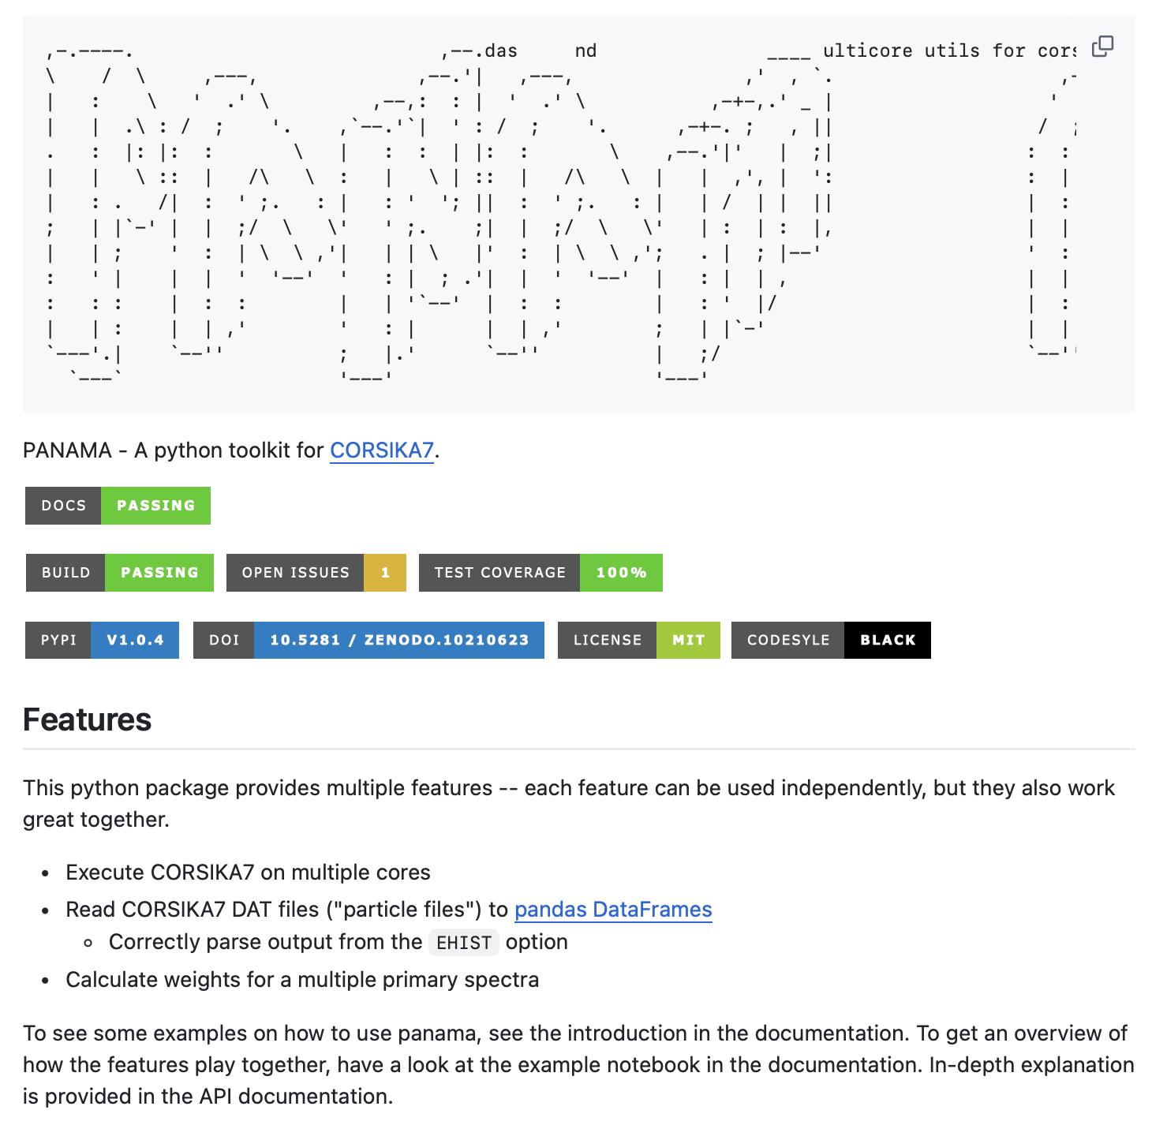
new python wrapper for CORSIKA 7
includes all tagging for prompt and conv
handles all “issues” with HGC
easy pip install
runs on multiple cores
converts DAT files to hdf5 files
https://github.com/The-Ludwig/PANAMA

Slide 10
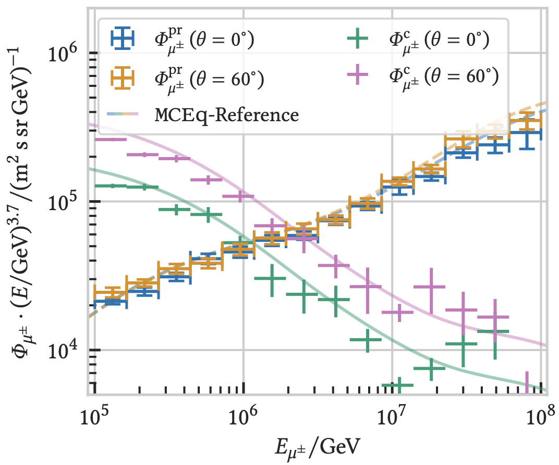
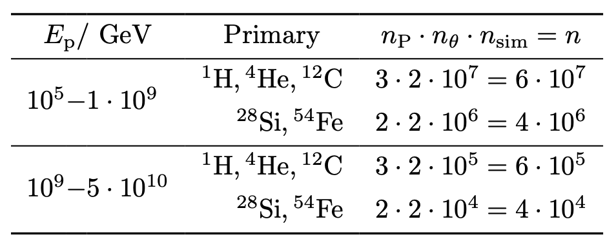
Compare results to MCEq
good agreement for inclusive flux
SIBYLL 2.3c vs. 2.3d

Slide 11
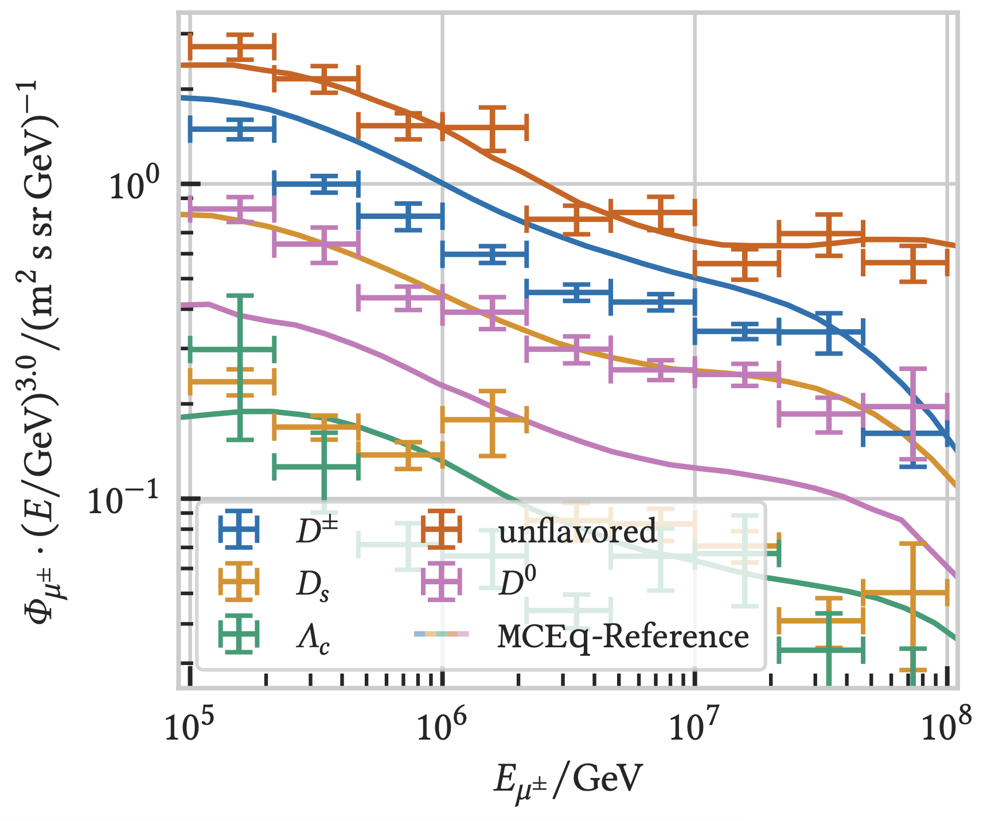
Compare to specific parent particles
D0 and DS are swapped in the official MCEq paper
Deviations for D± and DS
Good to have two independent methods
Inclusive flux agrees → that’s what we can measure

Slide 12
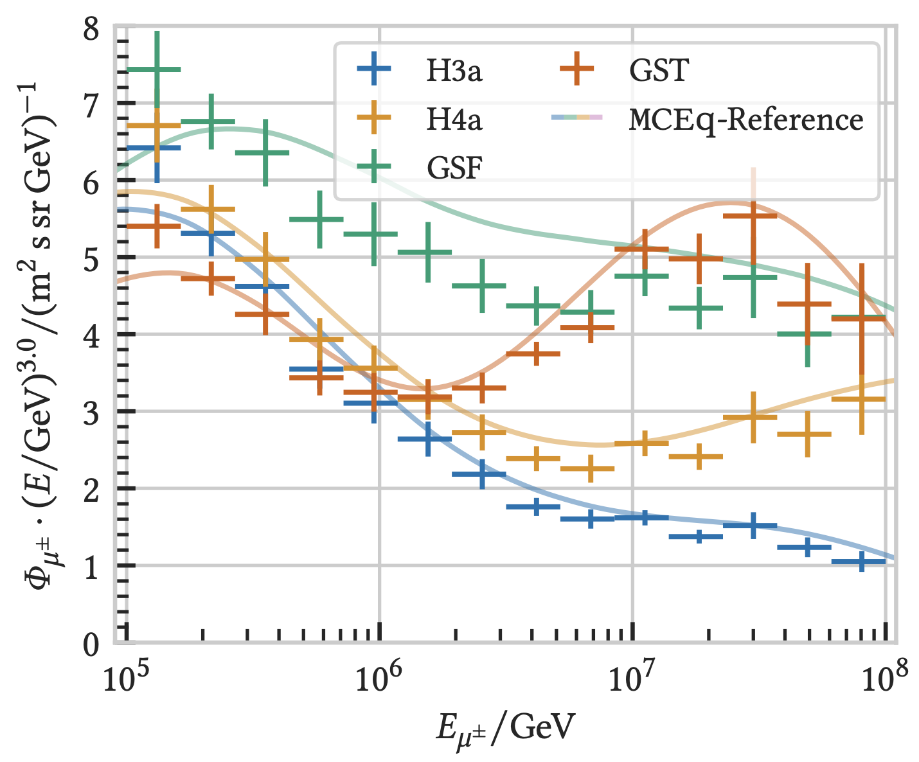
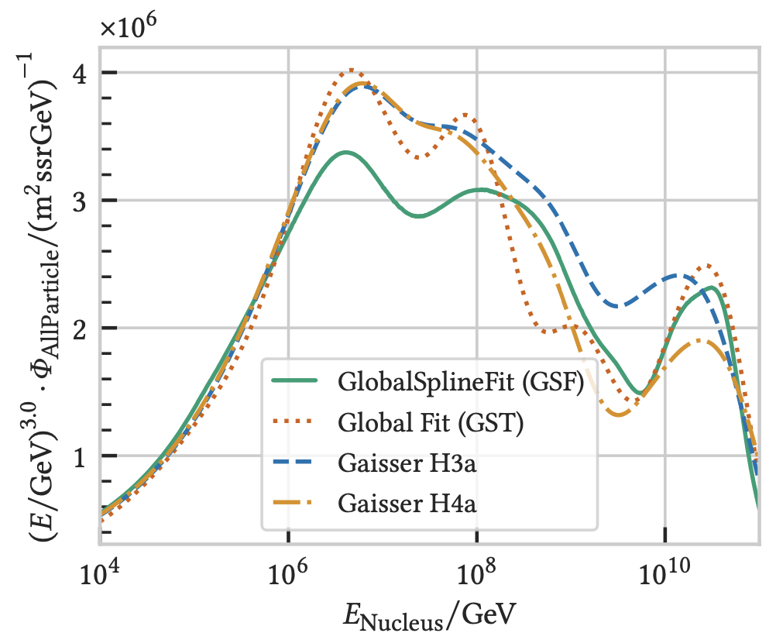
Influence of the primary flux model
shapes agree
nucleus flux

Slide 13
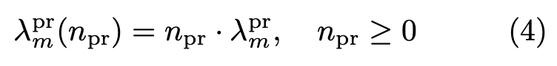
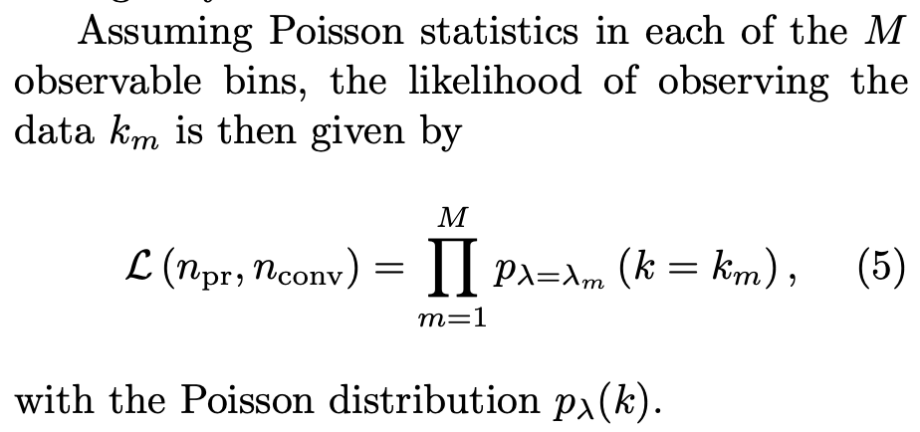
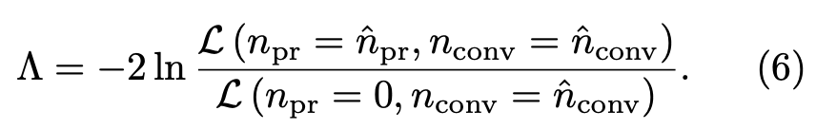
How to measure the prompt component?
currently worked on by Leander

Slide 14
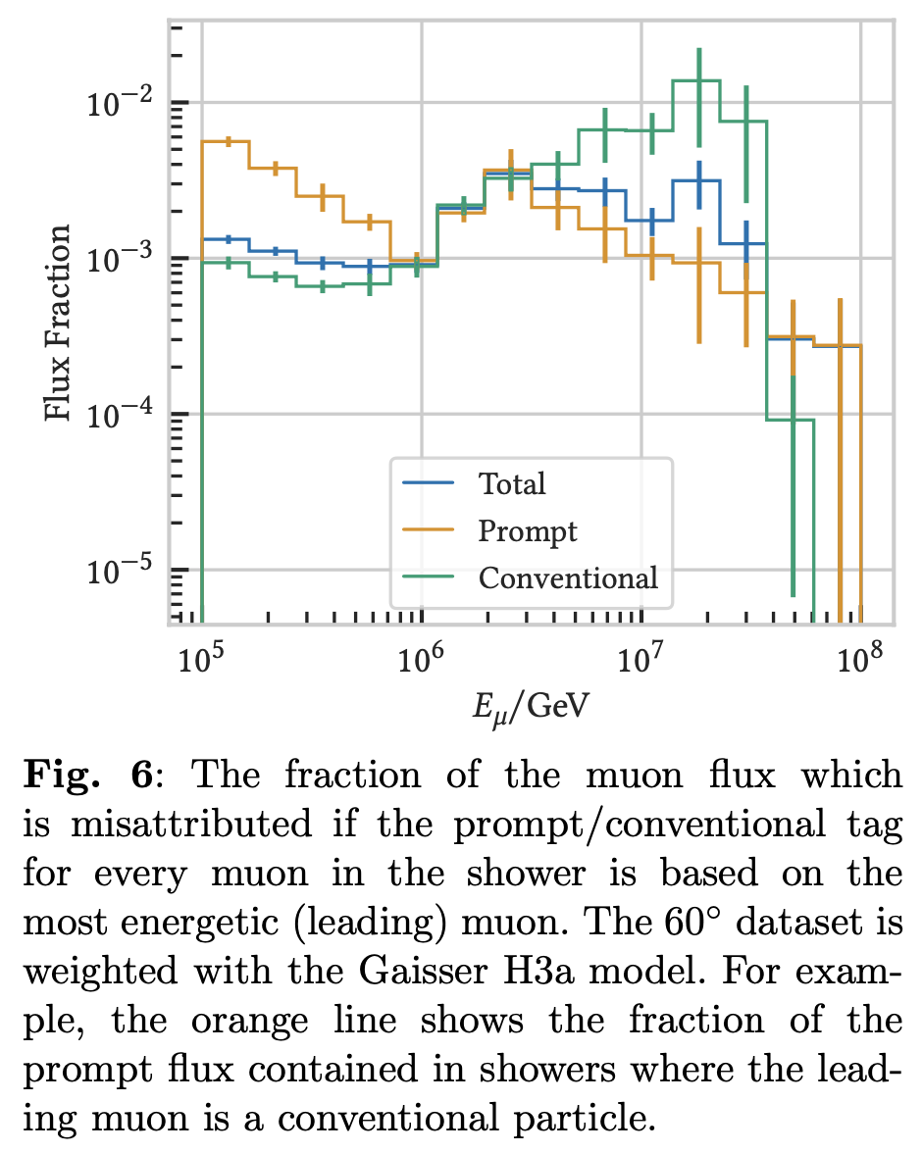
Leading muon definition

Slide 15
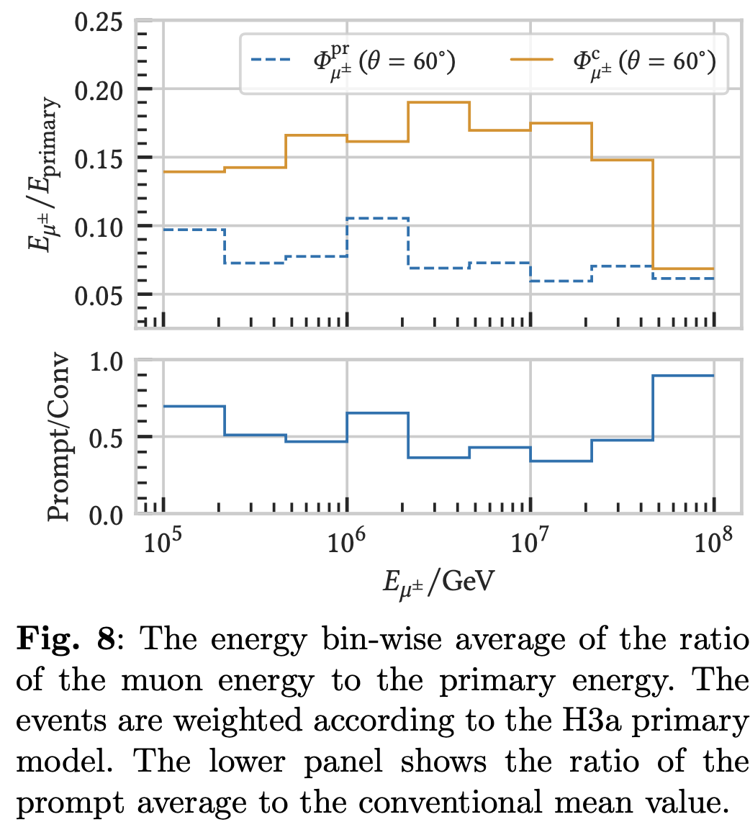
Relation to primary energy

Slide 16
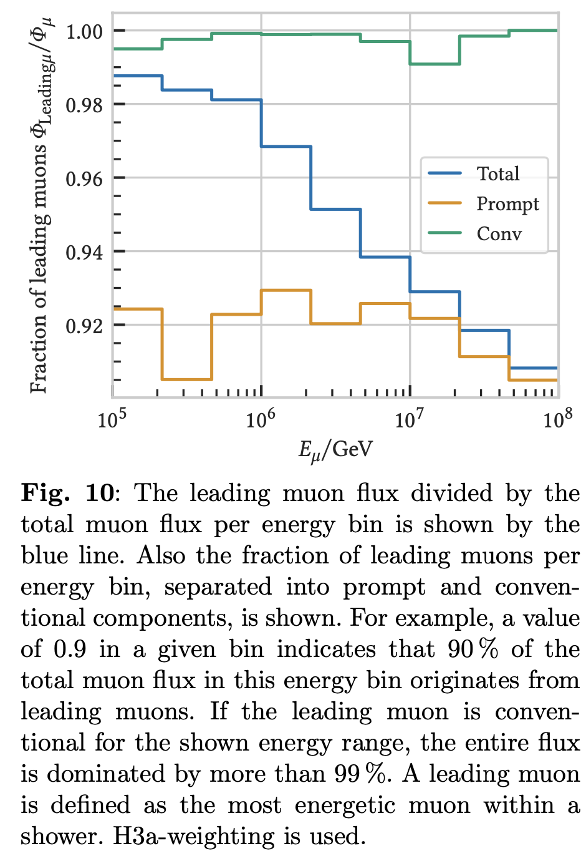
Leadingness

Slide 17
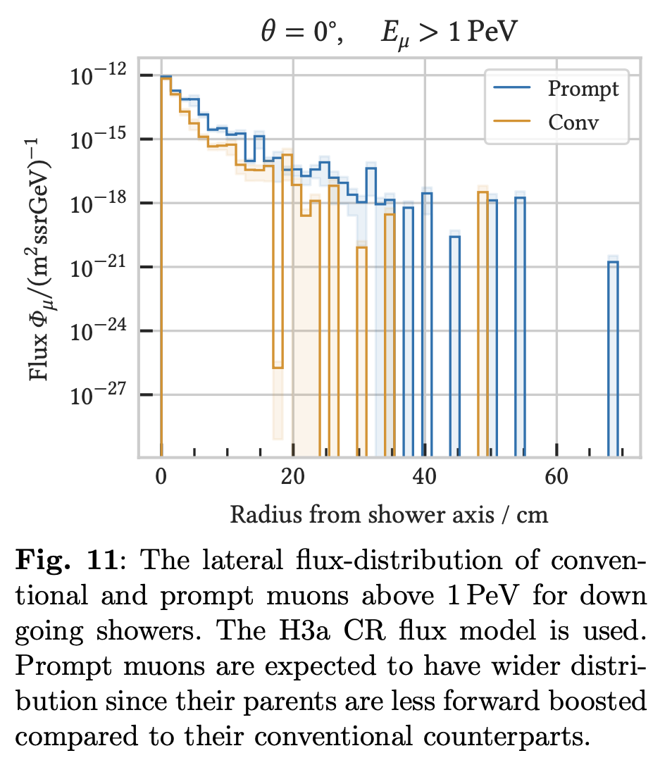
Lateral distribution

Slide 18
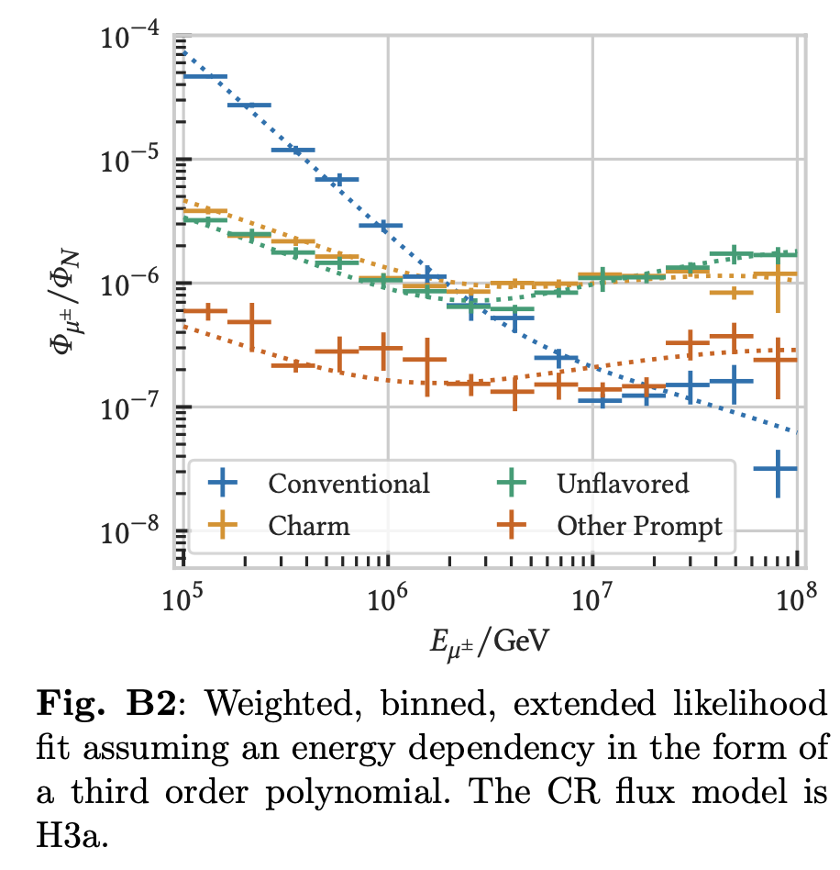
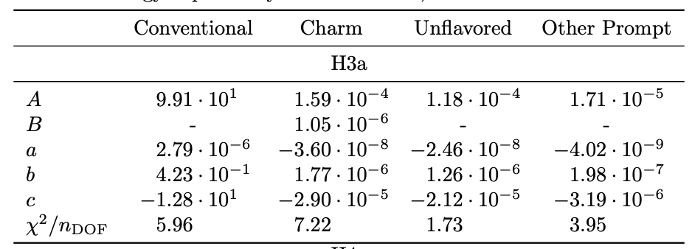
Flux parametrization

Slide 19
Conclusion
Prompt and conv definition
Tag prompt and conv in CORSIKA 7 simulations
provide open-source PANAMA tool (already used by Celina)
Validate results with MCEq comparisons
Present approach for prompt normalization measurement
Study prompt properties
prompt definition by leading muon
leadingness
energy relation to primary
lateral distribution
Parametrization for lepton fluxes from different origins for all 4 primary flux models

